Slide 1
SGA Assembly
10/23/2022
Presented by: SGA E-Board, Cole Churchill, and Darpan Chalal

Slide 2
TABLE OF CONTENTS
01.
02.
03.
Community Comment
Upcoming Events
Admin Meeting
04.
05.
06.
Board of Trustees
Our BOT Report
BOT Re-Cap
Open space for announcements, etc.
Space for concerns for upcoming administration meetings
What do they do?
What we put in our report, what does that mean etc.
Liaison meeting + General BOT Meeting

Slide 3
Community Comment

Slide 4
Upcoming Events!

Slide 5
Upcoming SGA Events
Night Market
Strike 101
Plenary
10/28 at 8pm in Great Hall! Decoration/Crafting days:
Monday (7-9pm)
Tuesday (7-9pm)
Wednesday (7-9pm)
11/6 Exhibit and Information session on the 2020 strike, student experiences, and what comes next
11/13 Review of all plenary resolutions, time for amendments and discussion
Last Workshop is Oct 24th

Slide 6
Upcoming School Wide Events
ASA Culture Show
FSDC
Concert Series y2k party
11/4 at 7:00pm in Great Hall
11/12: Student Dance Showcase at Haverford (Tri-Co dance groups)
11/5: Y2K themed dance party

Slide 7
Sign the FemCo Petition!
Message from Fem-Co: We believe that having access to menstruation products is a right that should be available on campus. FemCo wants to partner with Aunt Flow to make products accessible in every dorm bathroom, but we need your support. We are meeting with the Acting Dean of the College, Cheryl Horsey, on October 24th at 11:30 am. By this date, we need 367 more Bryn Mawr student signatures on our petition to reach quorum and end period poverty on this campus.

Slide 8
Community Comment for Admin Meeting

Slide 9
Board Of Trustees

Slide 10
Powers and Role of Board of Trustees
Approving all big college decisions
Committees
Advisory Groups
Investments/Endowment
Meet with members of BMC community, recommend items to the larger board ie finance committee, buildings and grounds
IE removing MCT’s name, officially being a HWC, the annual budget
IMAG, President’s advisory group
!!!!
Due to the lack of publicly available info, this is based off of the website and interactions we’ve had

Slide 11
Our Board of Trustees Report
Student Wages
Being a HWC
Covid Response
Increasing student wages to be competitive with surrounding businesses + put us in line with other colleges
Changing our official language to reflect our student population, we are not a women’s college
Bringing back free testing and other covid response measures to keep the community safe (testing, free masks)
Presented by Ananya Hindocha ‘23, Darpan Chahal ‘24, and Cole Churchill ‘25

Slide 12
IMAG Meeting
IMAG: Institutional Monuments Advisory Group
Discussed legacies of the strike and institutional memory projects on campus
Main Question: Should we remove M. Carey Thomas’s name from Old Library?

Slide 13
Liaison Meeting
Theme (set by Dean of the Undergraduate College): Transformation post pandemic
Our Main Points
Better support for student life/student clubs (administratively and monetarily)
Brought up burnout for AMO leaders
Monetary support for Student Leaders (ie SGA, AMO presidents)
Over 70% of American schools pay their student leaders
Bryn Mawr is the third most expensive HWC and the only one that doesn’t pay their SGA
Haverford pays their honor board

Slide 14
Annual Board of Trustees Meeting
Main Points from the General Meeting:
parking lot,
budget increases for park (renovations at $45 mil) and the well,
budget being made for next year (pre-lim presented at meeting in February
remodeling the field as part of the initiative to invigorating athletics
endowment is trending lower (market responses)
potential renovation on Arnecliffe and other buildings
Cartref, Hellfarian
conducting a review on investments and working with a private firm
they are re-deciding how long terms for trustees should be

Slide 15
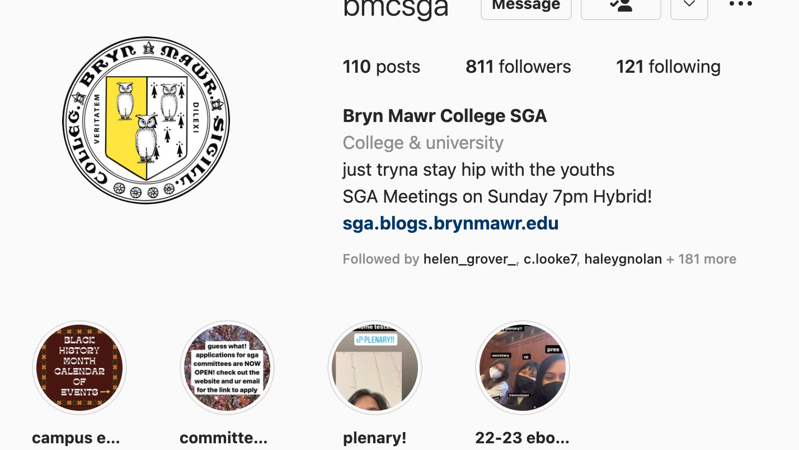
Stay Up to Date
Insta: @BMCSGA
Website:sga.blogs.brynmawr.edu
Email: sga@brynmawr.edu

